Slide 1
CUSTOMER RETENTION PROJECT
Submitted by
HARIHARA SUDHAN

Slide 2
Content:
Problem Statement
Data Analysing
Visualisations
Conclusion

Slide 3
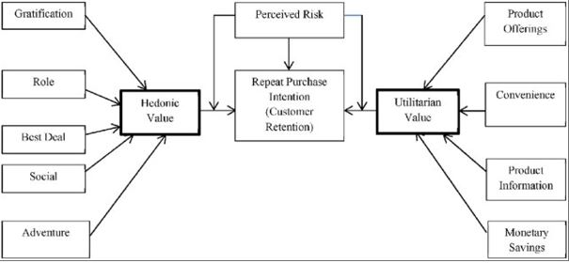

Slide 4
Problem Statement
In this modern era, ecommerce takes the vital role in everyones life.
Nowadays everyone having smartphone and internet in hand and that why ecommerce online shopping is developing day by day.
Since there are more competion maintaining the loyality is challenge.
Here in our project,there are many factors have been carried out to propose the models for customer activation and customer retention.
Our research is to investigated the factors that influence the online customers repeat purchase intention.
The more recommendations there are, the more universal the users' attitude is, which can be utilized to measure user satisfaction.

Slide 5
Data Analysis
Importing various python libraries such as NumPy and Pandas as well as Seaborn and Matplotlib libraries for visualization.
Checking the shape of the data,data types and checking null values and data cleaning process.
Shape of the data is (269,71).
There are no null values present in the dataset.
Types of data set is in object and int.

Slide 6
Visualisation
Female are more in number when compare to male in online shopping.
Delhi place the most online shopping counts when comparte to other cities.
Age between 20 to 40 are much in shopping online.
Using smart phone internet is high when compare to wifi and laptop..
Payment option and Return replacement method attracts the people more to online shopping.
Information on similar products and quality information makes the customers to strongly agree for online shopping.
Quickness to complete purchase and speed of delivery also plays major role for customers to strongly agree.

Slide 7
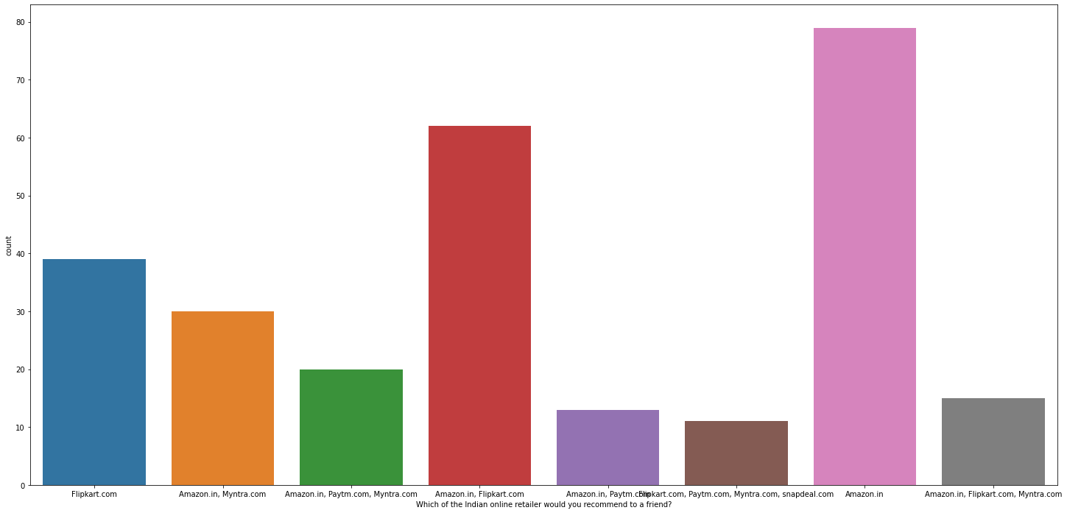
Amazon and flipkart are most trusted online selling App.

Slide 8
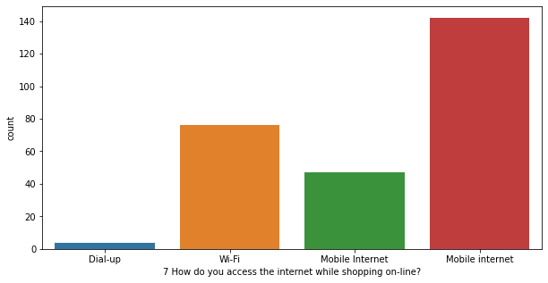
Mobile internet is more than 140 when compare to wife and dialup.

Slide 9
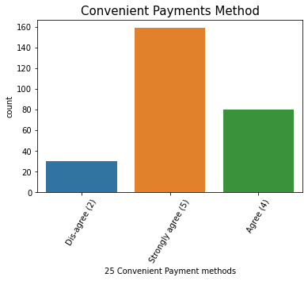
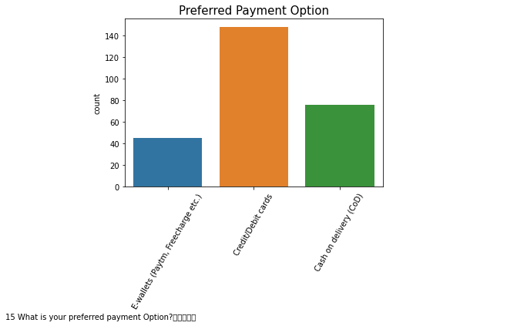
Since Payment methos is so convenient customers are strongly agree and using payment in credit /debit card is so high compare to others.

Slide 10
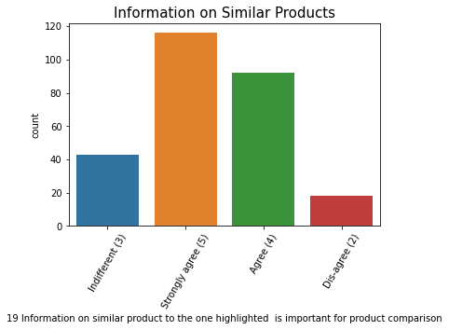
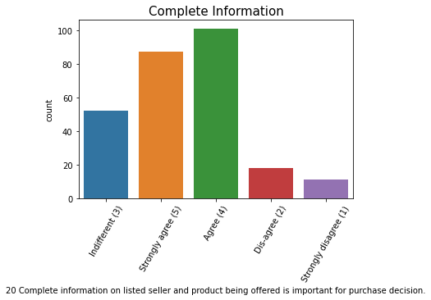
Providing product similar information and complete information about the project attracts the customer to high in online shopping.

Slide 11
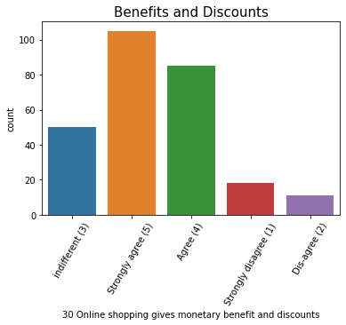
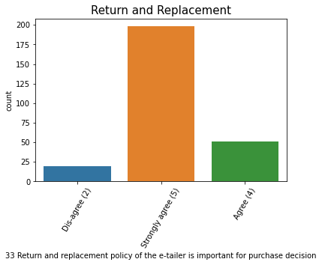
Giving more benefits and discounts with return and replacement method is very useful to for customers hence they strongly agree for it.

Slide 12
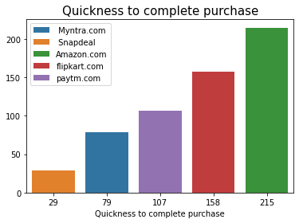
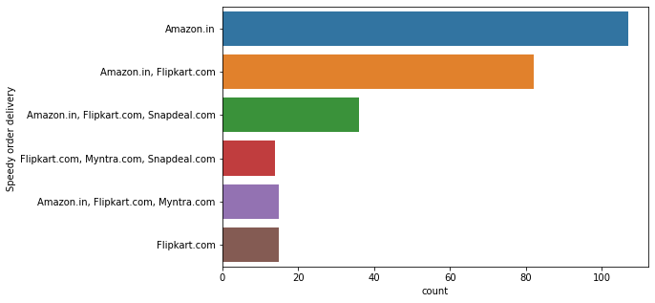
Quickness to complete the project and delivery speed was high in Amaz on and next to it was flipkart.

Slide 13
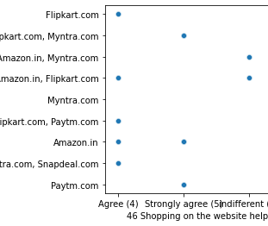
Corelation
Hedonic values are positively corelated to each other.

Slide 14
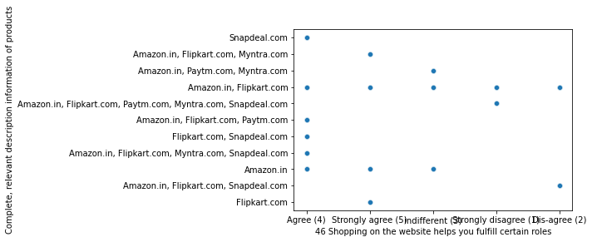
Corealtion:
Hedonic value and Complete relevant description information of products(Utilitarian value) are positively correlated to each other.

Slide 15
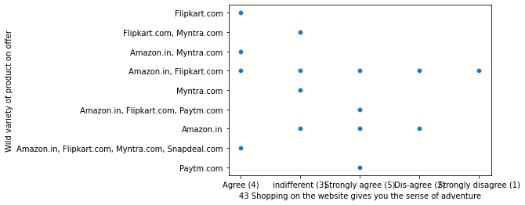
Corelation:
Hedonic value and Utilarian value are positiverly corelaterd..

Slide 16
Conclusion:
The variables which the consumers strongly agree on effects their opinion are – trustworthiness of the retailer, monitory benefits supporting the idea of value for money, empathetic customer assistance, functioning of the website, and complete relevant information on products.
In the collected data, we see that ‘Amazon.in’ is the most popular online retailer with the greatest number of recommendations.
When analyzed, the reason for amazon's popularity is precisely performing well in the above-mentioned factors.
The mediocre services and functioning of a website often prompt consumer dissatisfaction.

